Slide 1
MIT 6.875
Foundations of Cryptography
Lecture 25
Credit: Some slides adapted from Raluca Ada Popa and Vinod Vaikuntanathan

Slide 2

$O\left(1\right)$-Round Two-Party Computation

Slide 3




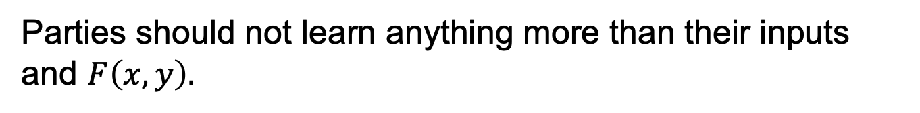
Secure Two-Party Computation
Input: $x$
Input: $y$
Alice
Bob
Alice and Bob want to compute $F\left(x,y\right).$
Semi-honest Security:
Parties should not learn anything more than their inputs and $F\left(x,y\right).$

Slide 4


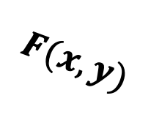
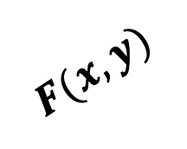
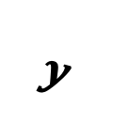
Secure Two-Party Computation
REAL WORLD:
Input: $x$
Input: $y$
Alice
Bob
≈
IDEAL WORLD:
$$y$$
$$x$$
$$F(x,y)$$
$$F(x,y)$$

Slide 5

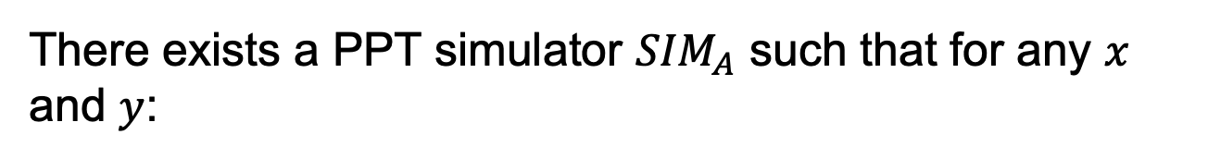
Secure Two-Party Computation
Input: $x$
Input: $y$
Alice
Bob
There exists a PPT simulator ${SIM}_{A}$ such that for any $x$ and $y$:
$${SIM}_{A}(x,F(x,y))≅{View}_{A}(x,y)$$

Slide 6

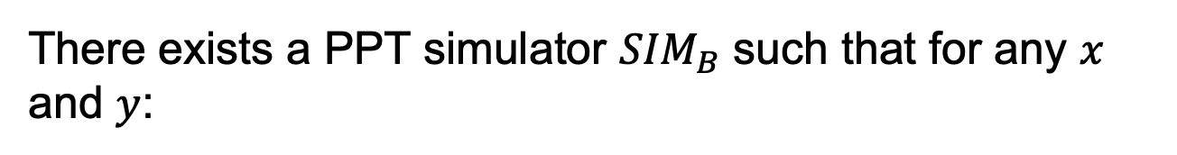
Secure Two-Party Computation
Input: $x$
Input: $y$
Alice
Bob
There exists a PPT simulator ${SIM}_{B}$ such that for any $x$ and $y$:
$${SIM}_{B}(y,F(x,y))≅{View}_{B}(x,y)$$

Slide 7

Secure MPC
Theorem [Goldreich-Micali-Wigderson’87]: OT can solve any multi-party computation problem.
One year before ‘87… Theorem (Yao'86):
OT+OWF solve any two-party computation problem.

Slide 8
Secure 2PC from OT
Constant Round!!
Groundbreaking generic solution
Inspired GMW’87 and more
Beyond secure computation
Computing on encrypted data
Secure function evaluation
Parallel cryptography
…
Garbling as Randomized Encoding of functions [IK’00,IK’02,AIK’04,AIK’06]…
Constant Round!!
Groundbreaking generic solution
Inspired GMW’87 and more
Beyond secure computation
Computing on encrypted data
Secure function evaluation
Parallel cryptography
…
Garbling as Randomized Encoding of functions [IK’00,IK’02,AIK’04,AIK’06]…

Slide 9


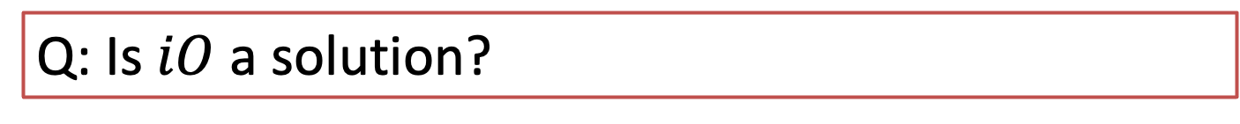
Secure Function Evaluation
Alice’s private input is $C:{\left\{0,1\right\}}^{n}→x$
Bob’s private input is $x$
Goal: Compute $C\left(x\right)$
Q: Is $iO$ a solution?
A: depends…
❌ SFE needs interaction
✅ But SFE gives one-time evaluation only.

Slide 10
Secure 2PC from OT
Constant Round!!
Groundbreaking generic solution
Inspired GMW’87 and more
Beyond secure computation
Computing on encrypted data
Secure function evaluation
Parallel cryptography
…
Garbling as Randomized Encoding of functions [IK’00,IK’02,AIK’04,AIK’06]…
Constant Round!!
Groundbreaking generic solution
Inspired GMW’87 and more
Beyond secure computation
Computing on encrypted data
Secure function evaluation
Parallel cryptography
…
Garbling as Randomized Encoding of functions [IK’00,IK’02,AIK’04,AIK’06]…

Slide 11
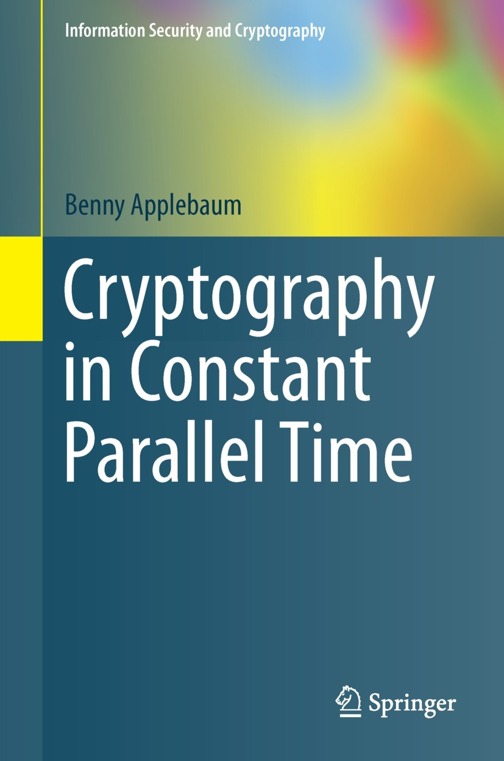
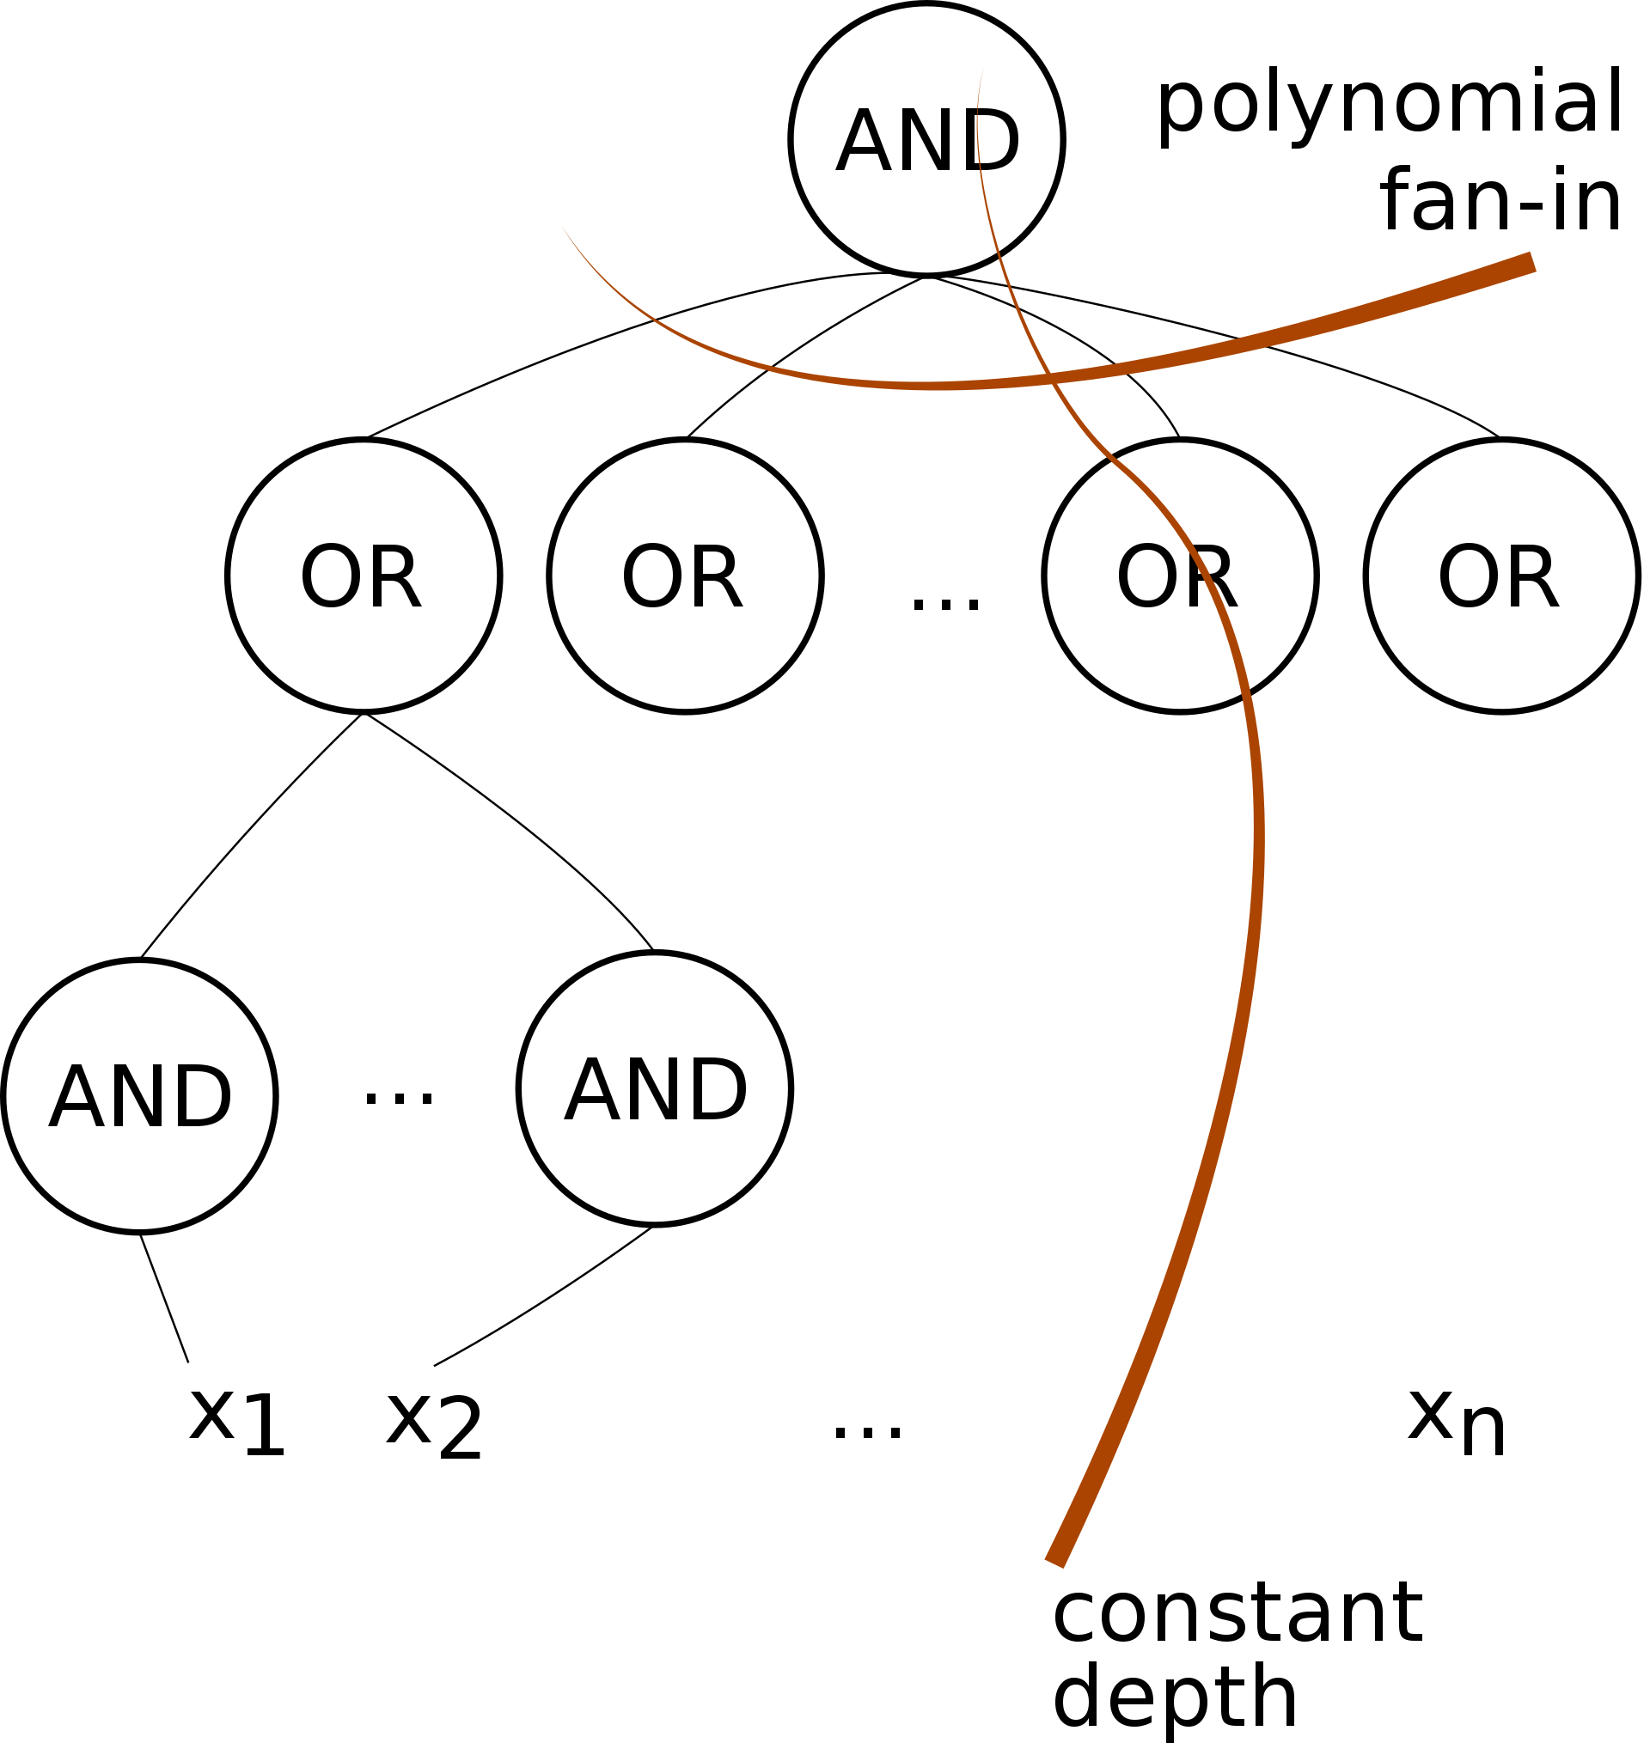
Parallel Cryptography
Can we do super-fast cryptography?

Slide 12
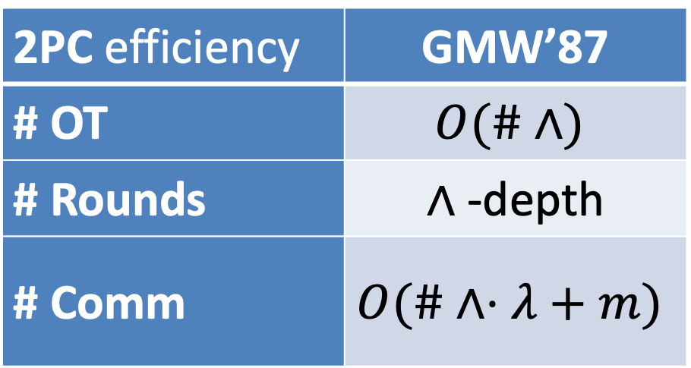
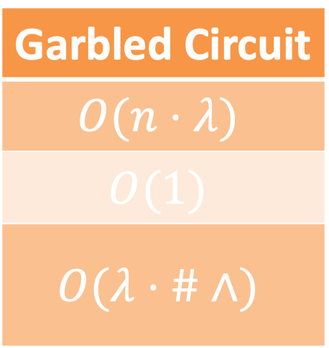
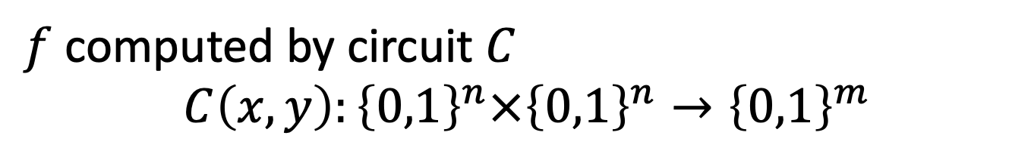
Complexity of the 2-party solution
$f$ computed by circuit $C$
$$C\left(x,y\right):{\left\{0,1\right\}}^{n}×{\left\{0,1\right\}}^{n}→{\left\{0,1\right\}}^{m}$$
2PC efficiency | GMW’87
# OT | $$O(\#∧)$$
# Rounds | $∧$-depth
# Comm | $$O(\#∧⋅λ+m)$$
Garbled Circuit
$$O(n⋅λ)$$
$$O(1)$$
$$O(λ⋅\#∧)$$

Slide 13


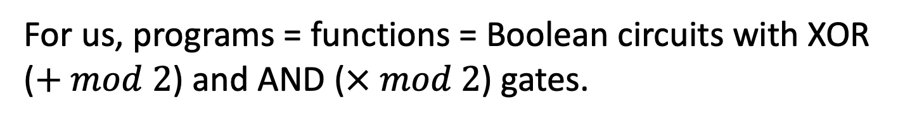
How to Compute Arbitrary Functions
For us, programs = functions = Boolean circuits with XOR ($+ mod 2$) and AND ($× mod 2$) gates.
X
+
X
Goal: Compute every gate without knowing what the inputs and outputs are

Slide 14

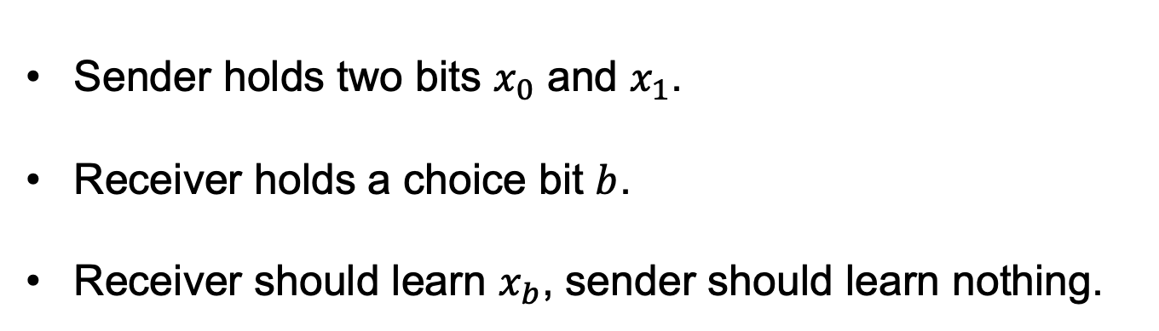
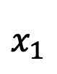
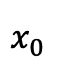
Tool: Oblivious Transfer (OT)
$$x_{0}$$
Choice bit: $b$
$$x_{1}$$
Sender
Receiver
Sender holds two bits $x_{0}$ and $x_{1}$.
Receiver holds a choice bit $b$.
Receiver should learn $x_{b}$, sender should learn nothing.

Slide 15
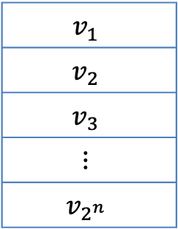

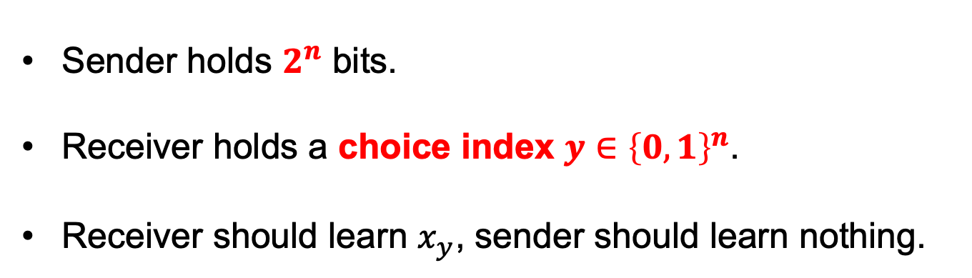

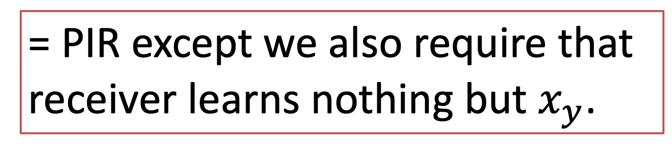
What if we have 1-out-of-$2^{n}$ OT?
$$v_{1}$$
$$v_{2}$$
$$v_{3}$$
$$⋮$$
$$v_{2^{n}}$$
Choice index:
$$y∈{\left\{0,1\right\}}^{n}$$
Sender
Receiver
Sender holds $2^{n}$ bits.
Receiver holds a choice index $y∈{\left\{0,1\right\}}^{n}$.
Receiver should learn $x_{y}$, sender should learn nothing.
= PIR except we also require that
receiver learns nothing but $x_{y}$.

Slide 16
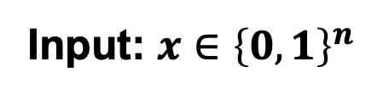
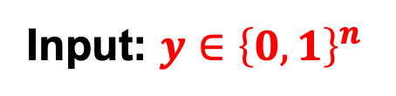
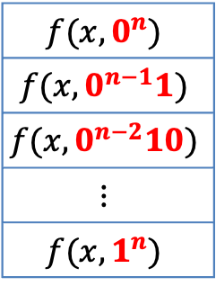
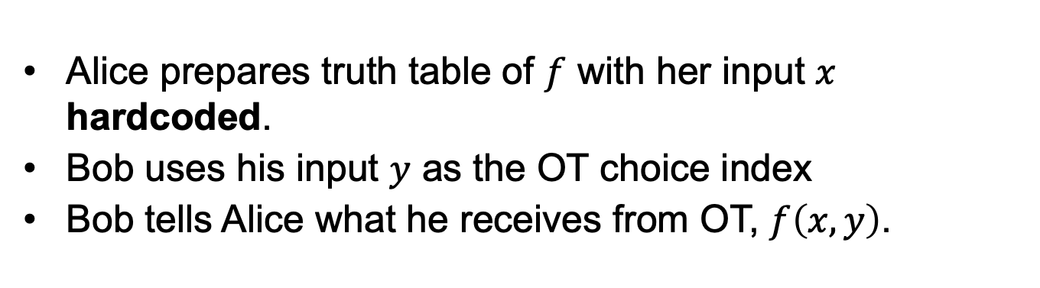

OT on Truth table?
$$f(x, 0^{n})$$
$$f(x,0^{n−1}1)$$
$$f(x,0^{n−2}10)$$
$$⋮$$
$$f(x,1^{n})$$
Input: $x∈{\left\{0,1\right\}}^{n}$
Input: $y∈{\left\{0,1\right\}}^{n}$
Alice
Bob
Alice prepares truth table of $f$ with her input $x$ hardcoded.
Bob uses his input $y$ as the OT choice index
Bob tells Alice what he receives from OT, $f\left(x,y\right)$.
We can try to get OT via some kind of tree construction. But expanding the truth table itself is already inefficient!
Gate-by-gate on circuit of $f$!

Slide 17
Fun with Lockboxes
Instead of deriving the OT-by-OT protocol of GMW’87…

Slide 18


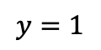

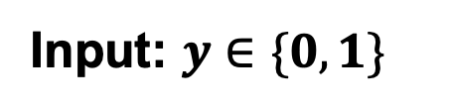
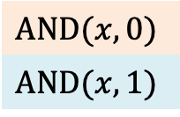
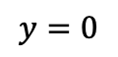
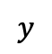
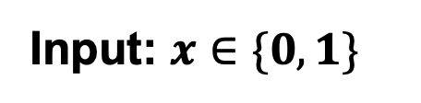
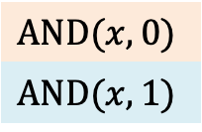
Physical 2PC
Input: $x∈\{0,1\}$
Input: $y∈\{0,1\}$
$$×$$
OT
$$y=0$$
$$y$$
$$y=1$$
$$AND(x, 0)$$
$$AND(x, 1)$$
$$AND(x, 0)$$
$$AND(x, 1)$$
This is way more complicated than OT.
Why do this?
Alice puts results in lock boxes
Bob gets key via some physical OT mechanism
Bob tries to open both boxes using the key he received.
Possession of or is information!

Slide 19
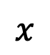
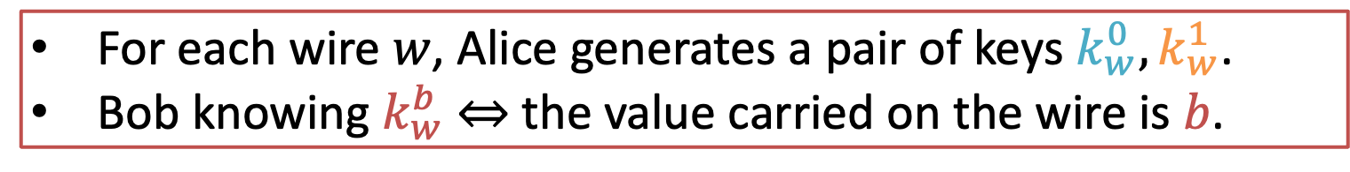

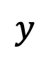
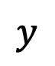


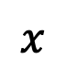
Physical 2PC
$$×$$
$$x$$
or
$$×$$
$$z$$
or
$$x$$
$$z$$
$$y$$
or
$$y$$
Blue/orange means 1/0, but keys on different wires, even with same colors, are different
For each wire $w$, Alice generates a pair of keys $k_{w}^{0}, k_{w}^{1}$.
Bob knowing $k_{w}^{b}$ $⇔$ the value carried on the wire is $b$.

Slide 20
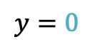
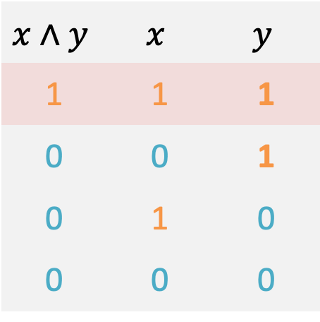
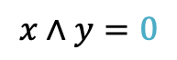
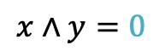
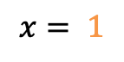
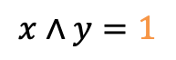
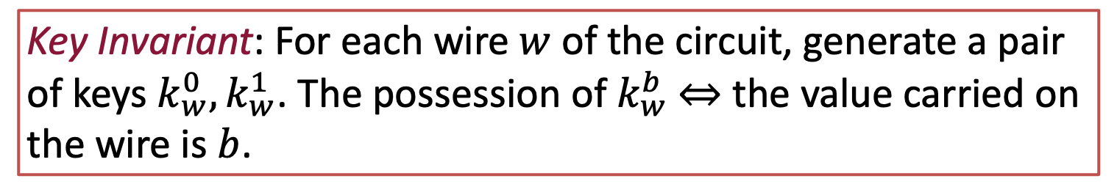
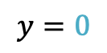
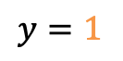
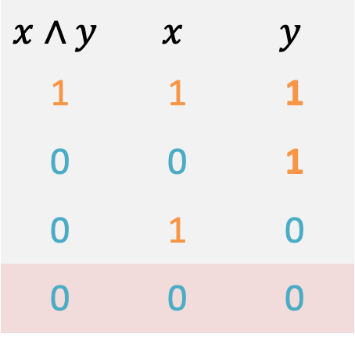
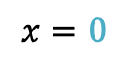
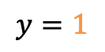
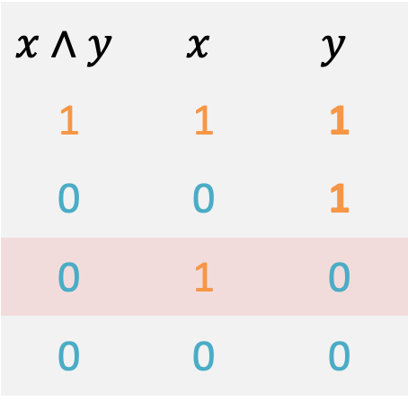
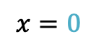
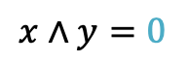



Idea
$$x∧y$$ | $$x$$ | $$y$$
1 | 1 | 1
0 | 0 | 1
0 | 1 | 0
0 | 0 | 0
$$x∧y$$ | $$x$$ | $$y$$
1 | 1 | 1
0 | 0 | 1
0 | 1 | 0
0 | 0 | 0
$$x∧y$$ | $$x$$ | $$y$$
1 | 1 | 1
0 | 0 | 1
0 | 1 | 0
0 | 0 | 0
$$x∧y$$ | $$x$$ | $$y$$
1 | 1 | 1
0 | 0 | 1
0 | 1 | 0
0 | 0 | 0
$$x∧y$$ | $$x$$ | $$y$$
1 | 1 | 1
0 | 0 | 1
0 | 1 | 0
0 | 0 | 0
$$x=0$$
$$x= 1$$
$$x=0$$
$$x= 1$$
$$×$$
$$x∧y=0$$
$$x∧y=0$$
$$x∧y=0$$
$$x∧y=1$$
$$y=0$$
$$y=0$$
$$y=1$$
$$y=1$$
Key Invariant: For each wire $w$ of the circuit, generate a pair of keys $k_{w}^{0}, k_{w}^{1}$. The possession of $k_{w}^{b}$ $⇔$ the value carried on the wire is $b$.

Slide 21





Idea
$$x∧y$$ | $$x$$ | $$y$$
1 | 1 | 1
0 | 0 | 1
0 | 1 | 0
0 | 0 | 0
$$x= 1$$
$$x= 1$$
$$×$$
$$x∧y=0$$
$$x∧y=1$$
$$y=0$$
$$y=1$$
Key Invariant: For each wire $w$ of the circuit, generate a pair of keys $k_{w}^{0}, k_{w}^{1}$. The possession of $k_{w}^{b}$ $⇔$ the bit $b$ is carried on $w$.

Slide 22









Garbled Evaluation
$$⊕$$
$$+$$
$$×$$

Slide 23
Crypto Lockboxes

Slide 24





Physical 2PC
Crypto
Input: $x∈{\left\{0,1\right\}}^{n}$
Input: $y∈\left\{0,1\right\}\%$
$$×$$
OT
$$AND(x, 0)$$
$$AND(x, 1)$$
$$y=0$$
$$y$$
$$y=1$$
$$AND(x, 0)$$
$$AND(x, 1)$$
Alice puts results in lock boxes
Bob gets key via some physical OT mechanism
Bob tries to open both boxes using the key he received.
in IND-CPA encryption
crypto
What about last point?

Slide 25

Tool: Special CPA Encryption
CPA-secure secret-key encryption $\left(Gen, Enc, Dec\right)$ that satisfies
Elusive range --- Let $k←_{R}Gen\left(1^{n}\right)$. Any p.p.t. adversary $A$ cannot generate ciphertext encrypted under $k$, w/o $k$.
Efficiently verifiable range --- there exists an algo $Check(1^{n}, k, c)$ that checks if $c$ is encrypted under $k$.

Slide 26


Tool: Special CPA Encryption
Elusive range --- Let $k←_{R}Gen\left(1^{n}\right)$. Any p.p.t. adversary $A$ cannot generate ciphertext encrypted under $k$, w/o $k$.
Efficiently verifiable range --- there exists an algo $Check(1^{n}, k, c)$ that checks if $c$ is encrypted under $k$.
Construction:
Let $F_{k}:{\left\{0,1\right\}}^{n}→{\left\{0,1\right\}}^{2n}$ be a PRF,
$$E_{k}\left( m;r\right)≔F_{k}\left(r\right)⊕(m|\left|0^{n}\right).$$
Any Ideas?

Slide 27



Crypto Lockboxes
Garbled gate
$$E_{k_{x}^{1}}(E_{k_{y}^{1}}\left(k_{z}^{1}\right))$$
$$E_{k_{x}^{0}}(E_{k_{y}^{1}}\left(k_{z}^{0}\right))$$
$$E_{k_{x}^{1}}(E_{k_{y}^{0}}\left(k_{z}^{0}\right))$$
$$E_{k_{x}^{0}}(E_{k_{y}^{0}}\left(k_{z}^{0}\right))$$
$$x$$ | $$y$$ | $$z$$
1 | 1 | 1
0 | 1 | 0
1 | 0 | 0
0 | 0 | 0
Efficiently verifiable range
$Check(1^{n}, k, c)$ checks if $c$ is encrypted under $k$.

Slide 28
Protocol Sketch

Slide 29









Yao’s protocol: Garbling
Keys generation: For each wire $w$ of $C$, Alice generates a pair of keys $k_{w}^{0}, k_{w}^{1}$.
Gate Garbling: For each gate $z←G\left(x,y\right)$, compute the tables.
Garbled gate
$$c_{i}^{1}$$
$$c_{i}^{2}$$
$$c_{i}^{3}$$
$$c_{i}^{4}$$
$$x$$ | $$y$$ | $$z$$
1 | 1 | 1
0 | 1 | 0
1 | 0 | 0
0 | 0 | 0
Garbled gate
$$c_{i}^{1}$$
$$c_{i}^{2}$$
$$c_{i}^{3}$$
$$c_{i}^{4}$$
Garbled gate
$$E_{k_{x}^{1}}(E_{k_{y}^{1}}\left(k_{z}^{1}\right))$$
$$E_{k_{x}^{0}}(E_{k_{y}^{1}}\left(k_{z}^{0}\right))$$
$$E_{k_{x}^{1}}(E_{k_{y}^{0}}\left(k_{z}^{0}\right))$$
$$E_{k_{x}^{0}}(E_{k_{y}^{0}}\left(k_{z}^{0}\right))$$
Garbled gate
$$c_{i}^{1}$$
$$c_{i}^{2}$$
$$c_{i}^{3}$$
$$c_{i}^{4}$$
Garbled gate
$$c_{i}^{1}$$
$$c_{i}^{2}$$
$$c_{i}^{3}$$
$$c_{i}^{4}$$
Garbled gate
$$c_{i}^{1}$$
$$c_{i}^{2}$$
$$c_{i}^{3}$$
$$c_{i}^{4}$$
$$\left|C\right|$$

Slide 30








Yao’s protocol: Evaluator Bob
Key Invariant: For each wire $w$ of the circuit, Bob can obtain exactly one of the two keys from $k_{w}^{0},k_{w}^{1}$.
$$k_{o}$$
X
$$k_{z}$$
$$k_{c}$$
+
X
$$x_{1}=a$$
$$y_{1}=b$$
$$x_{2}=a′$$
$$y_{2}=b′$$

Slide 31









Yao’s protocol: Evaluator Bob
Base case:
Alice’s input $x_{i}∈\left\{0,1\right\}$: Alice send the correct key $k_{i}^{x_{i}}$.
Bob’s input $y_{i}∈\{0,1\}$: they runs OT on (($k_{i}^{0},k_{i}^{1}), y_{i})$.
Key Invariant: For each wire $w$ of the circuit, Bob can obtain exactly one of the two keys from $k_{w}^{0},k_{w}^{1}$.
$$k_{o}$$
X
$$k_{z}$$
$$k_{c}$$
+
X
$$x_{1}$$
$$y_{1}$$
$$x_{2}$$
$$y_{2}$$
$$k_{a}^{x_{1}}$$
$$k_{b}^{y_{1}}$$
$$k_{a′}^{x_{2}}$$
$$k_{b′}^{y_{2}}$$

Slide 32






Yao’s protocol: Evaluator Bob
Inductive step:
Assume: Bob has one key for each input wire
Bob can get exactly one key for the output wire by trying all four ciphertexts.
Key Invariant: For each wire $w$ of the circuit, Bob can obtain exactly one of the two keys from $k_{w}^{0},k_{w}^{1}$.
$$k_{o}^{{(x}_{1}+x_{2})(x_{1}∧x_{2})}$$
$$k_{o}$$
X
Efficiently verifiable range $Check\left(1^{n}, k, c\right)∈\left\{0,1\right\}$ checks if $c$ is encrypted under $k$.
$$k_{z}$$
$$k_{c}^{x_{1}∧x_{2}}$$
$$k_{c′}^{x_{1}+x_{2}}$$
$$k_{c}$$
+
X
$$x_{1}$$
$$y_{1}$$
$$x_{2}$$
$$y_{2}$$
$$k_{a}^{x_{1}}$$
$$k_{b}^{y_{1}}$$
$$k_{a′}^{x_{2}}$$
$$k_{b′}^{y_{2}}$$

Slide 33

Evaluating One Gate
Inductive step:
Assume: Bob has one key for each input wire
Bob can get exactly one key for the output wire by trying all four ciphertexts.
Key Invariant: For each wire $w$ of the circuit, Bob can obtain exactly one of the two keys from $k_{w}^{0},k_{w}^{1}$.
Oops..
This procedure, as-is, is actually insecure.
Recall:
Garbled gate
$$E_{k_{x}^{1}}(E_{k_{y}^{1}}\left(k_{z}^{1}\right))$$
$$E_{k_{x}^{0}}(E_{k_{y}^{1}}\left(k_{z}^{0}\right))$$
$$E_{k_{x}^{1}}(E_{k_{y}^{0}}\left(k_{z}^{0}\right))$$
$$E_{k_{x}^{0}}(E_{k_{y}^{0}}\left(k_{z}^{0}\right))$$
Given $k_{x}^{b_{x}}, k_{y}^{b_{y}}$,
Try all four rows to obtain $k_{z}^{b_{x}∧b_{y}}$

Slide 34










Reconstructing Output
Key Invariant: For each wire of the circuit, Bob can obtain exactly one of the two keys associated with each wire.
After evaluation, Bob learns $k_{o}∈\{k_{o}^{0},k_{o}^{1}\}$.
Bob simply asks Alice if $k_{o}$ is $k_{o}^{0}$ or $k_{o}^{1}$.
$$k_{o}^{{(x}_{1}+x_{2})(x_{1}∧x_{2})}$$
$$k_{o}$$
X
Can we avoid this final round?
After Bob’s hard work, it is midnight and Alice is asleep...
$$k_{c}$$
$$k_{z}$$
+
X
$$a$$
$$b$$
$$a′$$
$$b′$$

Slide 35
Garbling as a Standalone Tool

Slide 36


Garbling as a Stand-Alone Tool
Q: Difference with $i𝒪$?

Slide 37

2PC Using Garbled Circuits

Slide 38
Simulation Proof Sketch

Slide 39



Simulating Alice
Imagine that the parties have access to an OT angel
Implemented by secure simulatable OT.
$$b$$
$$\left(L^{0},L^{1}\right)$$
$$L^{b}$$

Slide 40
Simulating Alice
Imagine that the parties have access to an OT angel.

Slide 41


Simulating Alice
Alice’s View
OT transcripts
$C\left(x,y\right)$
$Sim\left(C, x, f\left(x,y\right)\right)$ :
Output
$$\{{\left\{{Sim}_{OT}^{A}\left(L_{n+ i}^{0}, L_{n+ i}^{1}\right)\right\}}_{i}$$
$$f(x,y)\}$$

Slide 42
Simulating Bob
Imagine that the parties have access to an OT angel.

Slide 43

Simulating Bob
OT Simulation:
$${View}_{OT}^{B}≈{Sim}_{OT}^{B}\left(1^{n},y_{i}, L_{n+i}^{y_{i}}\right).$$
Assume we already simulated $L_{n+i}^{B}$ with the correct distribution.

Slide 44
Simulating Bob

Slide 45
Simulating Bob

Slide 46

Step 1: Generate Dummy Labels
Label generation: For each wire $w$ of $C$, generates a pair of keys $L_{w}^{0}, L_{w}^{1}$.
Label simulation: For all input wire $i$, let $\tilde{L_{i}^{x_{i}}}≔L_{i}^{0}$.
Sanity Check:
This replacement is fine because keys are randomly generated.

Slide 47





Step 2.a: Simulate Fake Gates
Garbled gate simulation: Replace intermediate ciphertexts with junks.
Garbled gate
$$E_{L_{x}^{1}}(E_{L_{y}^{1}}\left(L_{z}^{0}\right))$$
$$E_{L_{x}^{0}}(E_{L_{y}^{1}}\left(L_{z}^{0}\right))$$
$$E_{L_{x}^{1}}(E_{L_{y}^{0}}\left(L_{z}^{0}\right))$$
$$E_{L_{x}^{0}}(E_{L_{y}^{0}}\left(L_{z}^{0}\right))$$
Garbled gate
$$E_{L_{x}^{1}}(E_{L_{y}^{1}}\left(L_{z}^{1}\right))$$
$$E_{L_{x}^{0}}(E_{L_{y}^{1}}\left(L_{z}^{0}\right))$$
$$E_{L_{x}^{1}}(E_{L_{y}^{0}}\left(L_{z}^{0}\right))$$
$$E_{L_{x}^{0}}(E_{L_{y}^{0}}\left(L_{z}^{0}\right))$$
$$τ⋅$$
$$σ⋅$$
the rows are randomly permuted ($σ, τ∈Perm(\left[4\right]))$
only a random row can be decrypted
the junk entries are w.h.p. non-decryptable.

Slide 48


Step 2.b: Simulate Output
Generate the following decoding table
Output label | Decoded result
$$L_{o}^{0}$$ | $$C(x,y)$$
$$L_{o}^{1}$$ | $$1−C(x,y)$$
Sanity Check: This is fine because the label $L_{o}^{0}$ might as well be encoding $1$.

Slide 49

Simulating Bob
Bob’s View
Wire labels
Garbled tables
Final decoding table
OT transcripts
$Sim\left(C, y, f\left(x,y\right)\right)$ :
Simulate labels
$Sim_{OT}^{B}\left(L_{y}^{y_{i}}\right)$
Simulate garbled gates
Simulate final decoding table.

Slide 50
Efficiency

Slide 51



Garbling is parallelizable
X
X
Garbled gate
$$E_{L_{x}^{1}}(E_{L_{y}^{1}}\left(L_{z}^{1}\right))$$
$$E_{L_{x}^{0}}(E_{L_{y}^{1}}\left(L_{z}^{0}\right))$$
$$E_{L_{x}^{1}}(E_{L_{y}^{0}}\left(L_{z}^{0}\right))$$
$$E_{L_{x}^{0}}(E_{L_{y}^{0}}\left(L_{z}^{0}\right))$$
$$σ⋅$$
+
X
+
X
X
X
+
X
+
X
Parallelism: Each garbled gate is computed locally (only depends on $\left(L_{x}^{0},L_{x}^{1}\right),\left(L_{y}^{0},L_{y}^{1}\right),(L_{z}^{0},L_{z}^{1})$, generated at the very beginning).

Slide 52






Why is GMW sequential?
X
OT
$$s_{c}$$
$$s_{d}$$
+
OT
OT
X
$$s_{a}$$
$$s_{b}$$
$$s_{a′}$$
$$s_{b′}$$
Sequentiality: Input to next OT is output from previous OT.

Slide 53

Garbled-circuit 2PC
$f$ computed by circuit $C$
$$C\left(x,y\right):{\left\{0,1\right\}}^{n}×{\left\{0,1\right\}}^{n}→{\left\{0,1\right\}}^{m}$$
2PC efficiency | GMW’87 | Garbled Circuit
# OT | $$O(\#∧)$$ | $$O(n⋅λ)$$
# Rounds | $∧$-depth | $$O(1)$$
# Comm | $$O(\#∧⋅λ+m)$$ | $$O(λ⋅\#∧)$$

Slide 54
Optimization 1: Free XOR trick
In GMW or BGW, linear (XOR) gates are free (no communication).
Can we say something for Garbled circuits?
Theorem [Kolesnikov, Schneider’08]: If we generate labels carefully, then there is no need to send garbled XOR tables.
Observation: do not use so much randomness.

Slide 55

Optimization 1: Free XOR trick
Rough intuition:
Acceptable correlations of labels:
Pick global $R$, a random value hidden from evaluator
Generate non-XOR-output wire $w$ subject to
$$L_{w}^{b}=L_{w}^{1−b}⊕R$$
Now if $z=x⊕y$, we define $L_{z}=L_{x}⊕L_{y}$.
$L_{z}^{1}=L_{x}^{0}⊕L_{y}^{1}=L_{x}^{0}⊕L_{y}^{0}⊕R=L_{x}^{1}⊕L_{y}^{0}.$
$L_{z}^{0}=L_{x}^{1}⊕L_{y}^{1}=L_{x}^{0}⊕L_{y}^{0}.$
Observation: do not use so much randomness.

Slide 56

Optimization 2: Half-Gates
Half-gate trick [Zahur, Rosulek, Evans’15]: Keeping XOR gates free, AND gate can be 2 ct each.
Credit: Table taken from proceedings version of [ZRE’15].

Slide 57


Optimization 3: Beyond Half-Gates
Slicing & Dicing [Rosulek, Roy’21]: Keeping XOR gates free, AND gate can be $1.5$ ct plus 5 bits each.
Credit: Table taken from proceedings version of [RR’21].

Slide 58
Malicious Alice
What can a malicious garbler do?

Slide 59

Simple Generic Defense
Cut-and-choose
What can a malicious Garbler do?
Rough sketch:
Alice commits to $q$ garbled gates and the randomness in generating them.
Bob opens all but one instances, including all the labels, and check that gates are garbled correctly; if not, abort.
Use the unopened GC to compute.
Note: Use of commitment is crucial:
Soundness: Only $1/q$.
How do we get soundness error: $2^{Ω(q)}$?

Slide 60
Malicious Bob
What can a malicious evaluator do?

Slide 61
Next class: Quantum Cryptography

